Slide 1
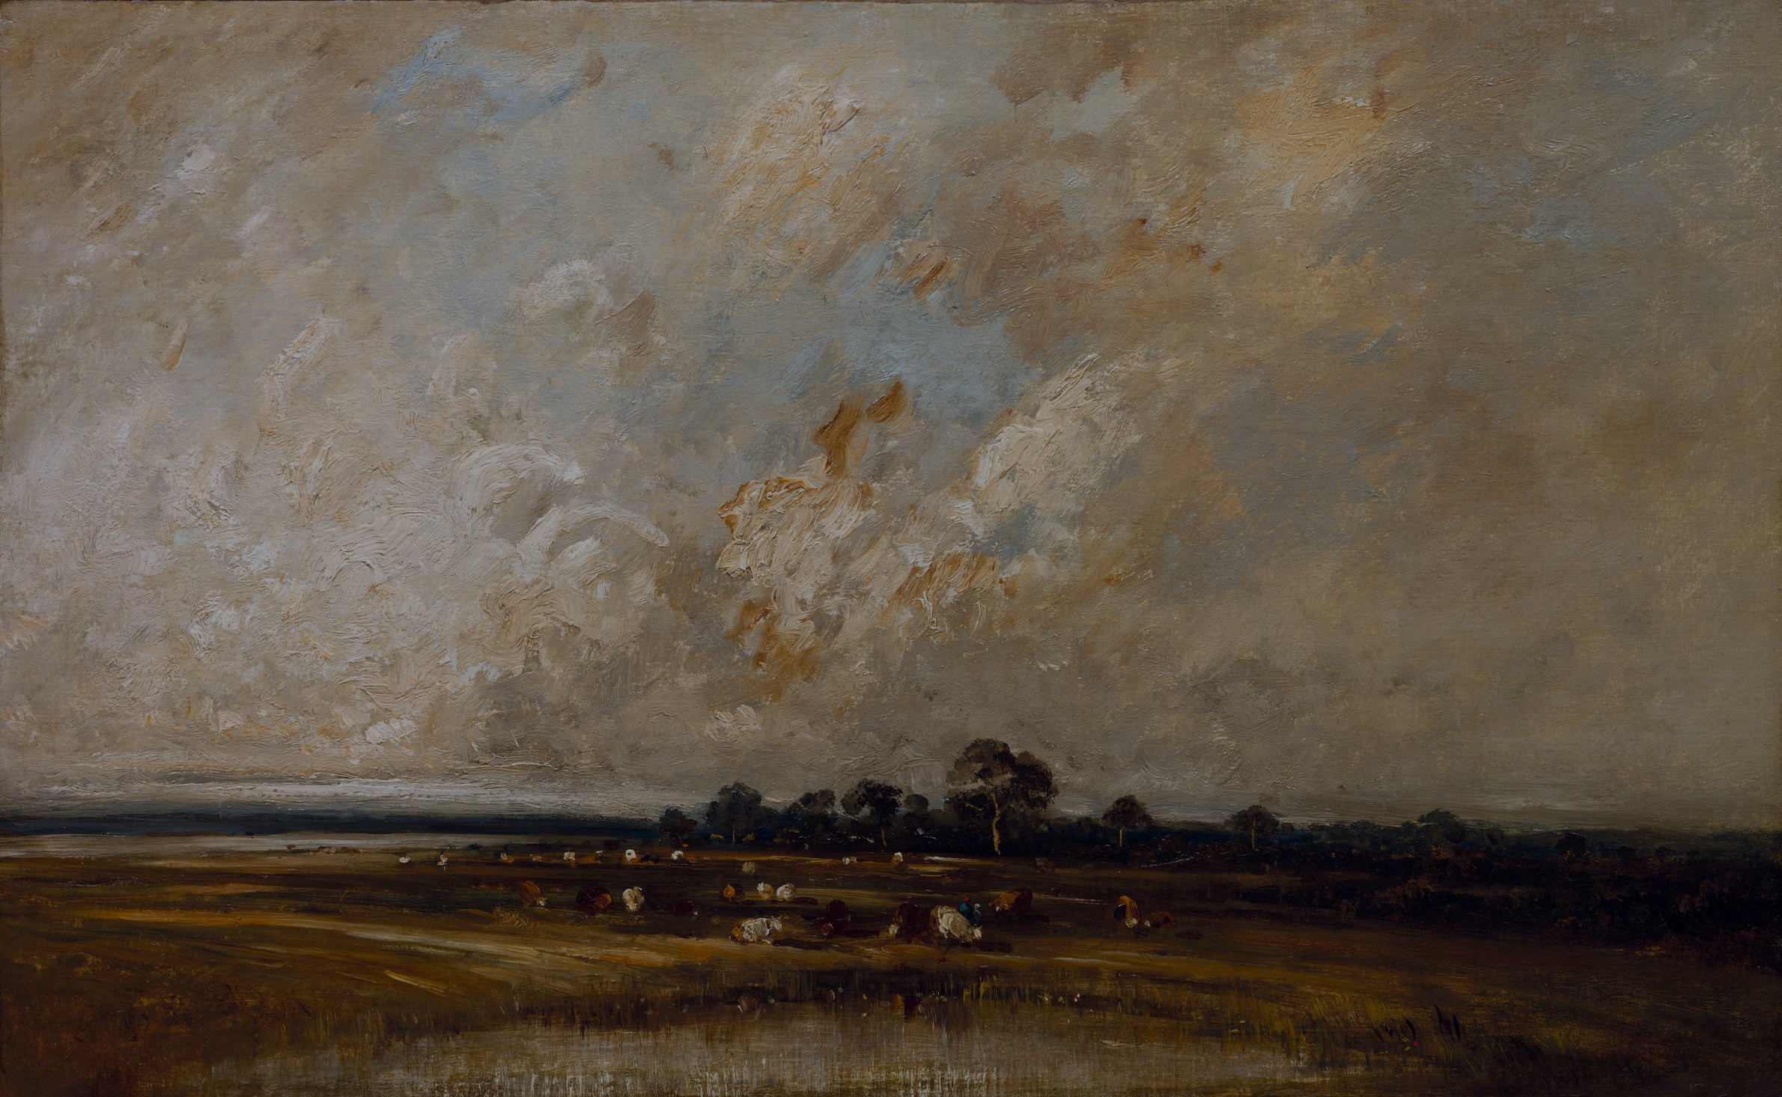
We present you all a presentation on :
RIGHT AGAINST EXPLOITATION
By Forward Thinkers

Slide 2

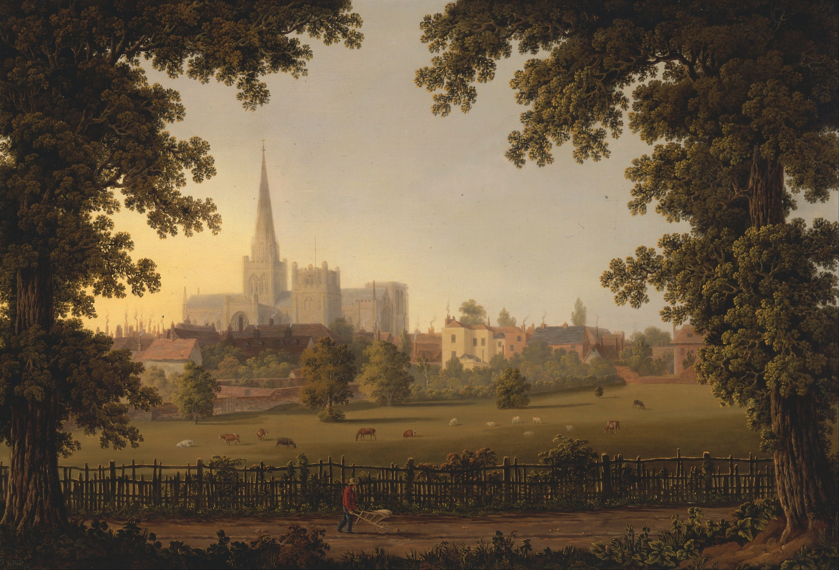
Introduction
The Constitution of India is the supreme law of the country. It lays down the basic principles, rules, and laws according to which the nation is governed. One of its most important features is the inclusion of Fundamental Rights, which guarantee freedom, equality, and justice to all citizens and protect them from misuse of power.
Among these Fundamental Rights is the Right against Exploitation. This right protects people from being forced into unfair labour practices and from being treated in an inhuman manner. It ensures that no one is exploited because of poverty or helplessness. The Right against Exploitation is mentioned under Articles 23 and 24 of the Indian Constitution and plays a vital role in upholding human dignity and social justice.

Slide 3


What is Right Against Exploitation?
The Right against Exploitation is a Fundamental Right that protects people from being forced to work against their will or being treated unfairly. It prohibits practices like human trafficking, forced labour, and child labour. This right ensures that every individual can live with dignity and freedom. It is guaranteed under Articles 23 and 24 of the Indian Constitution.

Slide 4
Prohibition of Human Trafficking :
(Article 23)
Article 23 of the Indian Constitution strictly prohibits human trafficking and forced labour. Human trafficking means the buying and selling of human beings for illegal purposes such as forced work, domestic servitude, or exploitation.
This article also bans begar, which refers to work taken from a person without payment or against their will. It protects poor and helpless people from being forced into labour due to debt, pressure, or threat.
Any form of trafficking or forced labour is a punishable offence under law, and the State is responsible for preventing such exploitation and protecting human dignity.

Slide 5
Forms of Exploitation under Article 23:
01
Human Trafficking – Buying and selling of human beings for forced labour, domestic work, or other illegal activities.
02
Begar – Forced work without payment or against a person’s will.
03
Bonded Labour – People forced to work to repay a debt, often for very low or no wages.
04
Forced Labour – Work done under threat, pressure, or fear, especially due
to poverty or helplessness.
05
Exploitation of Women and Children – Using women and children for
labour or other abusive purposes.

Slide 6
Article 24: Prohibition of Child Labour
Article 24 of the Indian Constitution prohibits the employment of children below the age of 14 years in factories, mines, and other hazardous occupations. This article aims to protect children from work that can harm their physical health, mental development, and moral well-being.
Child labour often forces children to work in unsafe conditions instead of going to school. Article 24 ensures that children are given the opportunity to receive education, grow safely, and enjoy their childhood. It places a responsibility on the State to take necessary steps to prevent child exploitation.
To strengthen this right, several laws have been enacted, such as the Child Labour (Prohibition and Regulation) Act, which strictly punishes those who employ children in prohibited occupations.

Slide 7
Why is the Right against Exploitation
Important?
The Right against Exploitation is important because it protects people from being treated as objects or tools for profit. It ensures that every individual is respected as a human being and can live with dignity and freedom. Without this right, poor and vulnerable sections of society could be easily forced into unfair and inhuman labour.
This right helps in preventing serious social evils such as human trafficking, bonded labour, forced labour, and child labour. By banning these practices, it safeguards the physical and mental well-being of people, especially women and children, who are more vulnerable to exploitation.
The Right against Exploitation also supports education and development. By prohibiting child labour in hazardous industries, it ensures that children attend school and grow in a safe environment. This contributes to the overall development of the nation.
Lastly, this right promotes social justice and equality. It reduces economic and social exploitation and helps in building a fair and humane society where no one is forced to work against their will.

Slide 8
Laws Supporting the Right against
Exploitation
The Bonded Labour System (Abolition) Act, 1976 abolishes the bonded labour system and frees workers who are forced to work to repay debts. It makes employing bonded labour a punishable offence and ensures rehabilitation of freed labourers.
The Child Labour (Prohibition and Regulation) Act, 1986 prohibits the employment of children below 14 years of age in hazardous occupations and regulates their working conditions in non-hazardous jobs. This law aims to protect children’s health, education, and overall development.
The Immoral Traffic (Prevention) Act, 1956 prevents trafficking of persons, especially women and children, for commercial exploitation. It provides punishment for those involved in trafficking and exploitation.
The Minimum Wages Act, 1948 also supports this right by ensuring that workers are paid fair wages, thus reducing forced labour caused by extreme poverty.

Slide 9
Imaginary Case: Violation of the Right against Exploitation
Raju is a 12-year-old boy from a poor village. A contractor promises his parents that Raju will get light work and proper care in a city factory. However, after reaching the city, Raju is forced to work for long hours in a firecracker factory without proper safety measures. He is not paid wages regularly and is not allowed to attend school.
This situation violates Article 23, as Raju is forced to work against his will, and Article 24, because a child below 14 years is employed in a hazardous industry. The contractor is guilty of exploiting a child and denying him his fundamental rights.

Slide 10
Conclusion
The Right against Exploitation is one of the most important Fundamental Rights guaranteed by the Indian Constitution. It protects individuals from cruel practices such as human trafficking, forced labour, bonded labour, and child labour. By ensuring that no person is forced to work against their will, this right upholds human dignity and freedom.
This right plays a crucial role in protecting the poor, weak, and vulnerable sections of society, especially women and children. It also ensures that children are given the opportunity to study, grow, and enjoy a safe childhood instead of being pushed into unsafe and harmful work.
Supported by various laws and government actions, the Right against Exploitation helps in building a just, equal, and humane society. Awareness and strict enforcement of this right are essential to eliminate exploitation and to ensure justice and equality for all citizens.

Slide 11

Q&A
SESSION

Slide 12
THANK YOU
By Forward Thinkers (Group4)

